Slide 1
Some Review

Slide 2
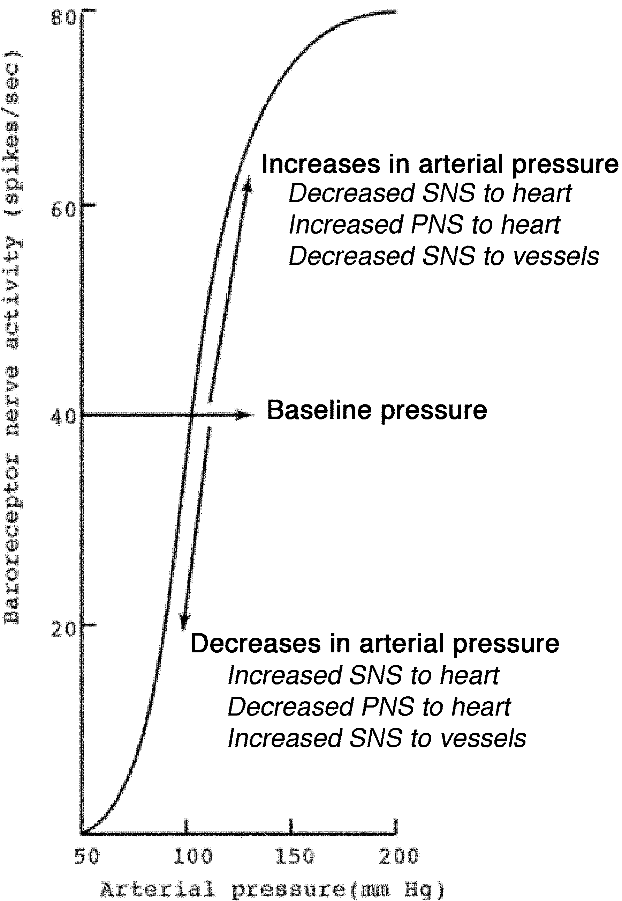
The Baroreceptor Reflex
Increases or decreases in blood pressure induce baroreceptor-mediated changes in sympathetic and parasympathetic activity
Baroreceptor activity displays “ceiling” and “floor” effects

Slide 3
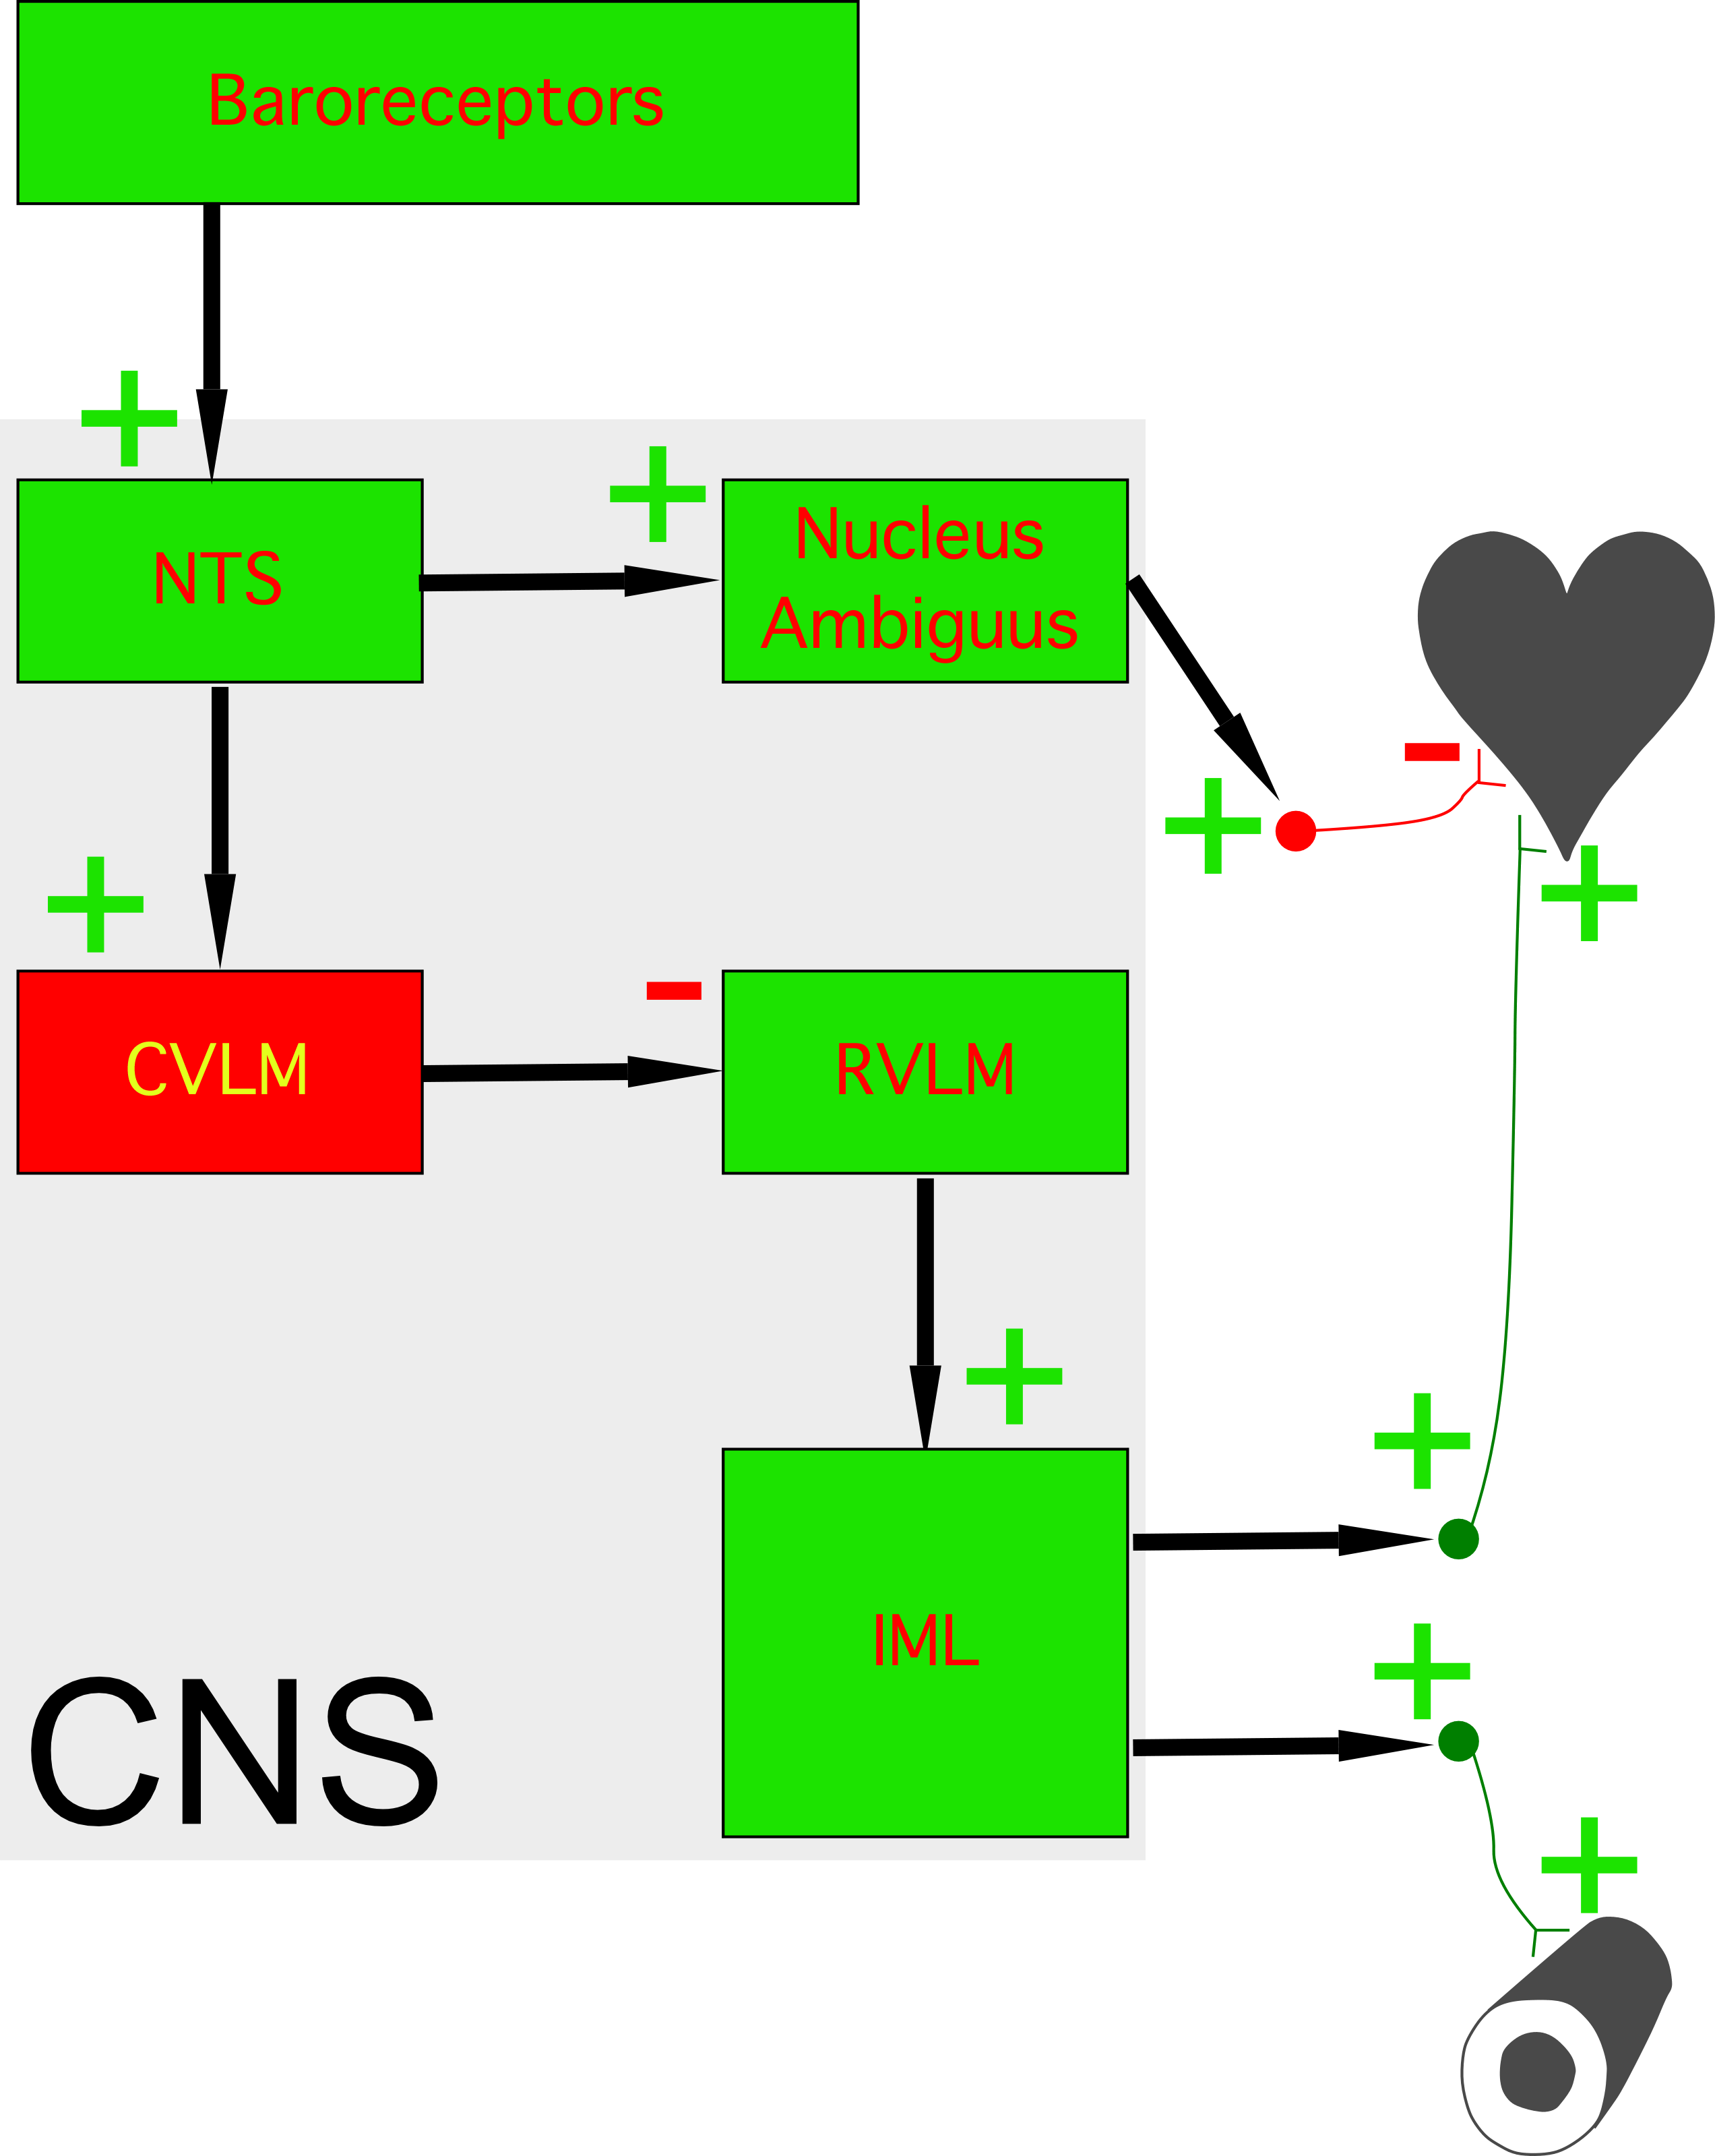
Neural Basis of the Baroreceptor Reflex

Slide 4
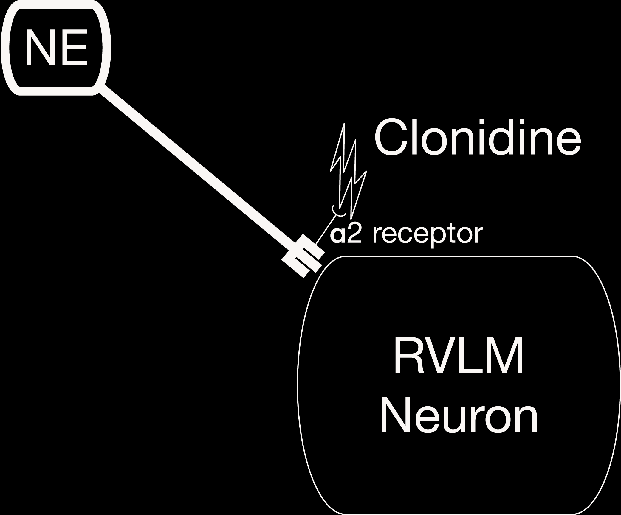
Clonidine—Acts in RVLM to Lower Blood Pressure

Slide 5
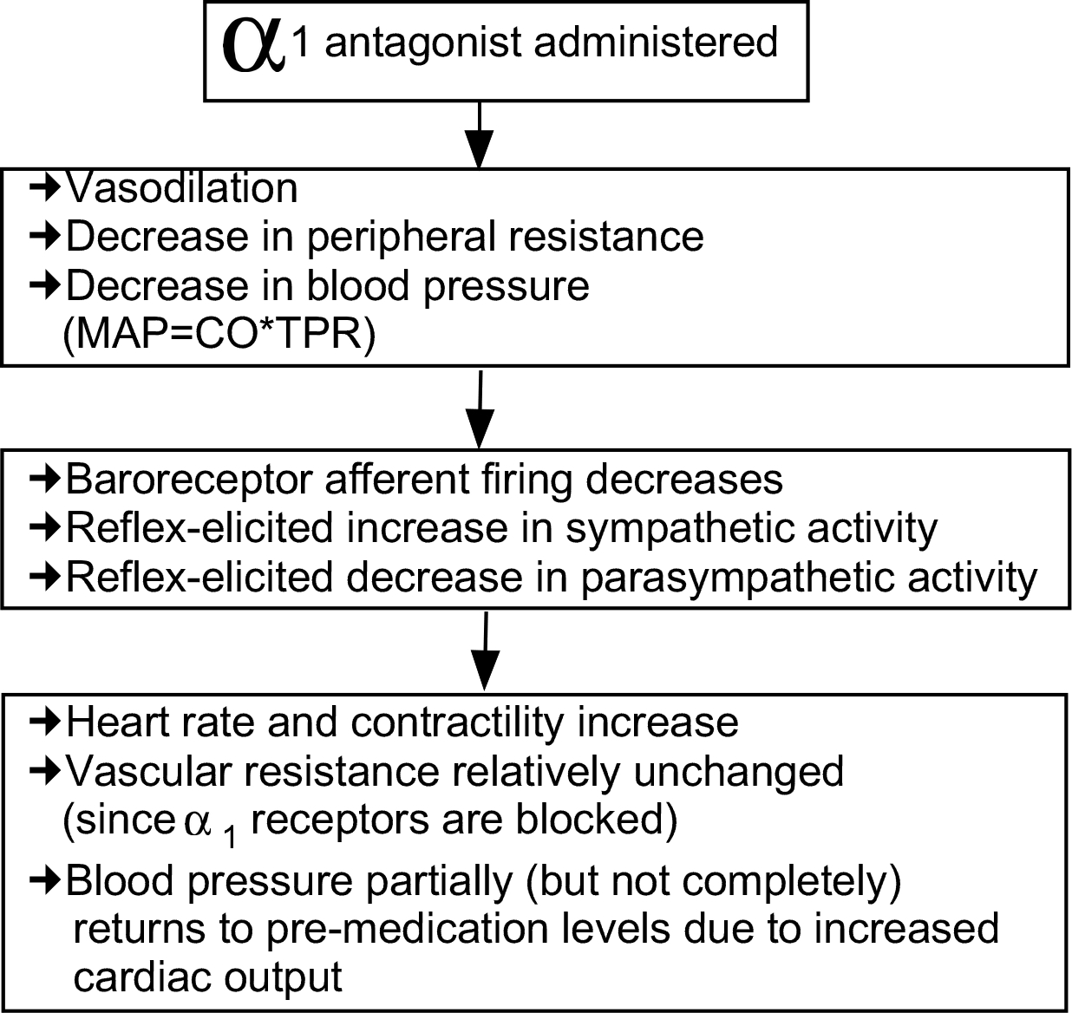
The Baroreceptor Reflex Alters the Effects of Cardiology Drugs

Slide 6
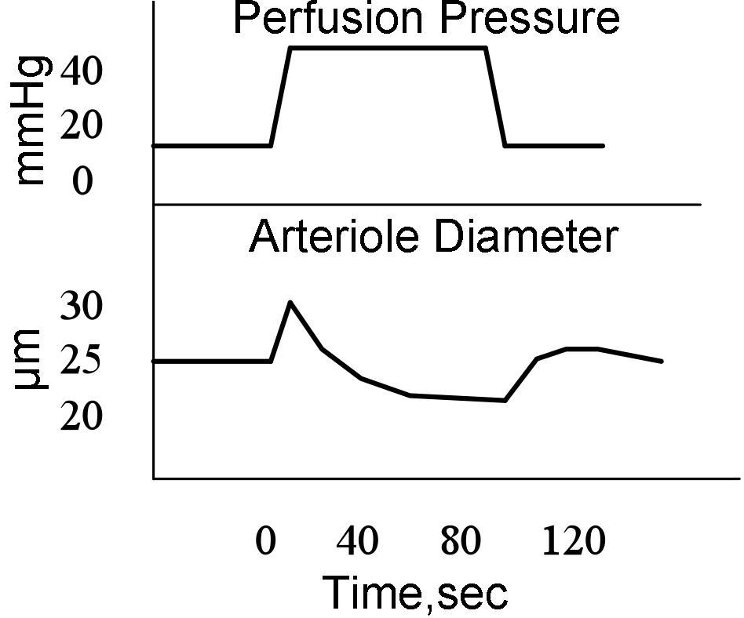
Myogenic Autoregulation
A rise in pressure stretches the wall of vascular smooth muscle cells, opening stretch-sensitive Na+ channels, thereby resulting in a depolarization of the cell.
This depolarization elicits an opening of voltage-gated Ca2+ channels on the surface, increasing Ca2+ and triggering vasoconstriction.
Consequently, vessel diameter will become smaller as perfusion pressure rises.
Autoregulation provides for a constant rate of O2 delivery regardless of perfusion pressure.

Slide 7
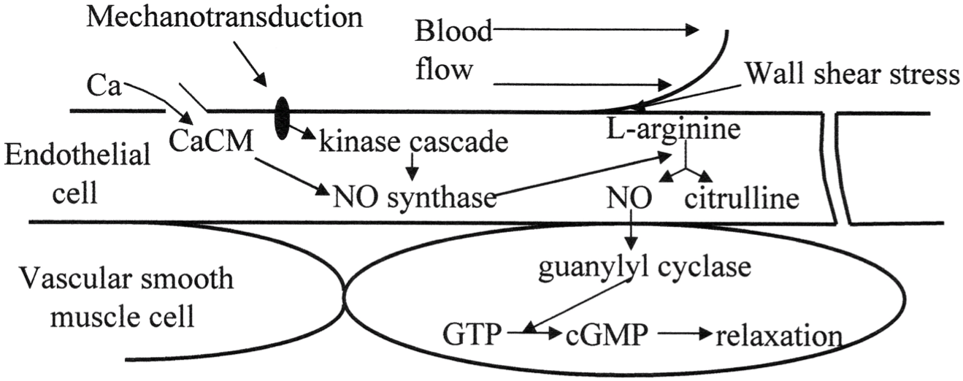
Endothelium-Derived Relaxing Factor

Slide 8
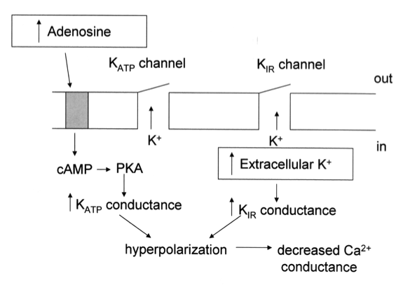
Paracrine Control of Local Blood Flow

Slide 9
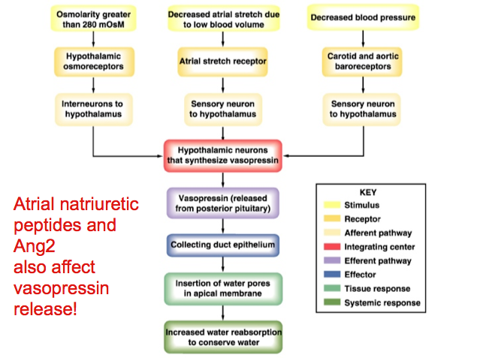
Vasopressin

Slide 10
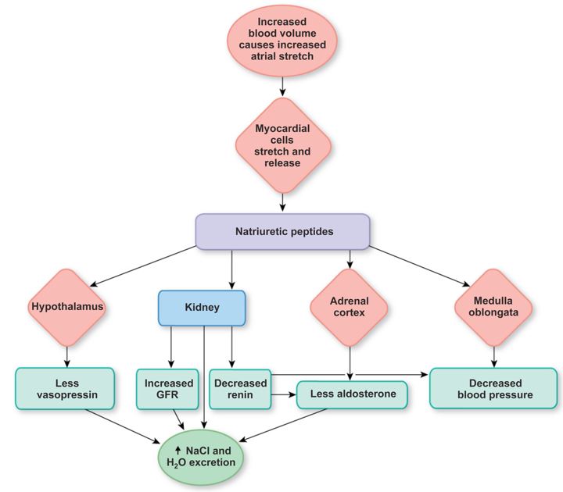
Atrial Natriuretic Factor (Peptide)

Slide 11
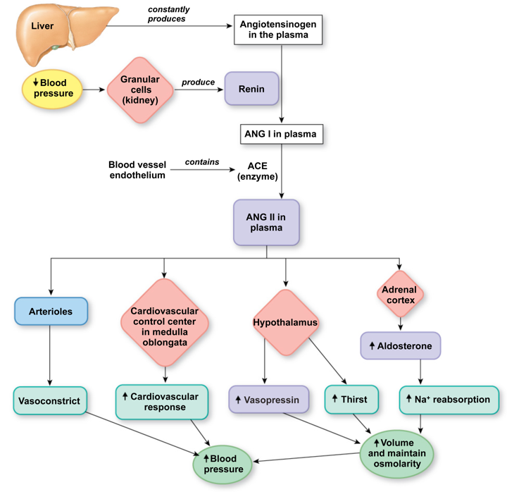
Summary of Angiotensin 2 Actions

Slide 12
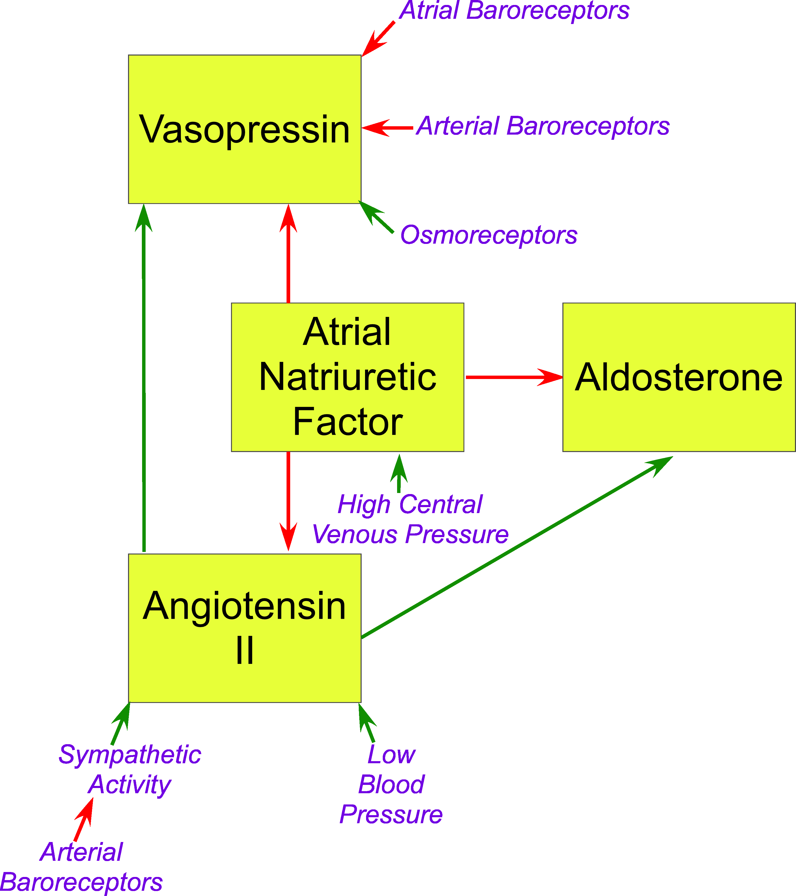

Slide 13
Starling Equation
J_{v} = K_{f} ([P_{c}—P_{i}] — σ [π_{c}—π_{i}])
If J_{v} is positive, fluid leaves the capillary
(filtration)
If J_{v} is negative, fluid enters the capillary
(absorption)

Slide 14
Increased Venous Pressure
Arteriole
Venule
^{J}_{v} ^{≈ ([60 — (-3)] — [25 — 5])}
^{J}_{v} ^{≈ ([40 — (-3)] — [25 — 5])}
^{J}_{v} ≈ 43
^{J}_{v} ≈ 23
Filtration occurs across the entirety of the capillary; considerable fluid is lost into the interstitial space!

Slide 15
Hypoproteinemia
Arteriole
Venule
^{J}_{v} ^{≈ ([25 — (-3)] — [11— 2])}
^{J}_{v} ^{≈ ([10 — (-3)] — [11— 2])}
^{J}_{v} ≈ 19
^{J}_{v} ≈ 4
Filtration occurs across the entirety of the capillary; considerable fluid is lost into the interstitial space!

Slide 16
Hemorrhage
Arteriole
Venule
^{J}_{v} ^{≈ ([15— (-3)] — [25 — 5])}
^{J}_{v} ^{≈ ([5— (-3)] — [25 — 5])}
^{J}_{v} ≈ -2
^{J}_{v} ≈ -12
Consequently, fluid is absorbed from the interstitial space into the intravascular compartment. Over time, this movement of fluid will serve to increase blood volume, thereby increasing blood pressure.

Slide 17
Increased Capillary Permeability
Assume 40% increase in K_{f}
Arteriole
Venule
^{J}_{v} ≈ 1.4 * ([25 — (-3)] — [25 — 5])
^{J}_{v} ≈ 1.4 *([10 — (-3)] — [25 — 5])
^{J}_{v} ≈ 11.2
^{J}_{v} ≈ -9.8
The net filtration pressure increases to 1.4; more loss of fluid into the interstitial space!

Slide 18
Example: Infusion of Hypertonic Saline
Hypertonic Saline
Intravenous delivery of hypertonic saline results in the osmolarity of the intravascular space being higher than the interstital space.
Consequently, water leaves the interstitial space (osmosis) until the water concentration on the two sides of the capillary are equal.
As a result, the water concentration is higher in the intracellular space than in the interstitial space, and water leaves the cell.
Due to the loss of fluid, the cell shrinks.
H₂O
Cell
Shrinks
H₂O

Slide 19
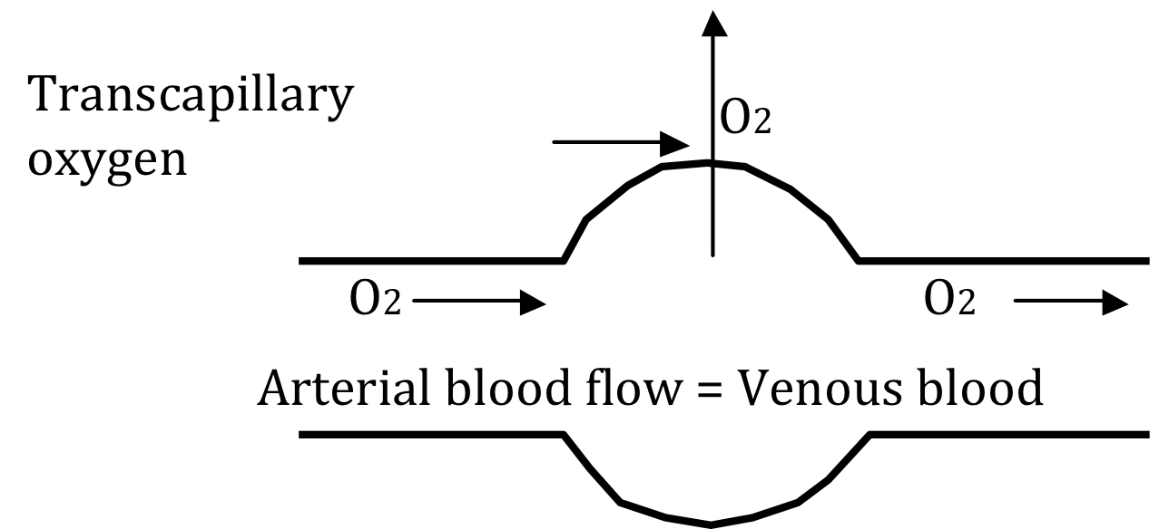
Measurement of Oxygen Delivery to Tissues: the Fick Principle
Let:
CaO₂ = arterial O₂ content (O₂/ml blood)
CvO₂ = venous O₂ content (O₂/ml blood)
F = blood flow (ml/min)
Then:
Rate of O₂ delivery = F * CaO₂ (O₂/min)
Rate of O₂ removal = F * CvO₂ (O₂/min)
QO₂ (oxygen delivery) = F * CaO₂ — F * CvO₂
OR
QO₂ (oxygen delivery) = F * (CaO₂ — CvO₂)
Applying algebra:
F = QO₂/(CaO₂ — CvO₂)

Slide 20
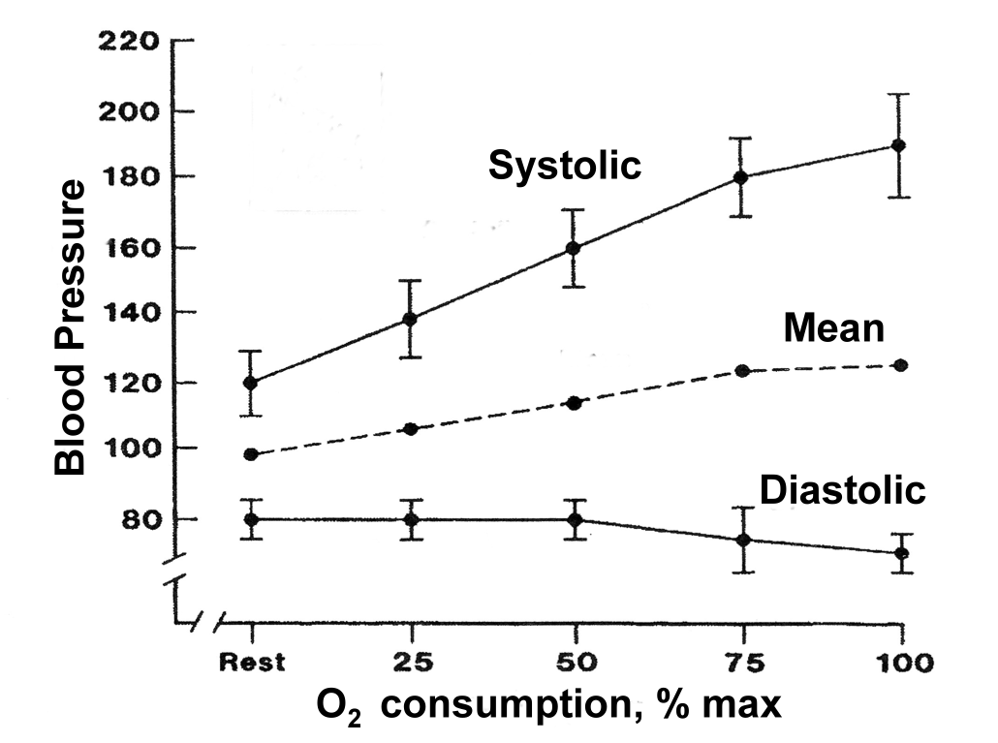
Only Moderate Increases in Blood Pressure Occur During Exercise, Despite the Huge Increase in Cardiac Output
Systolic pressure increases markedly during exercise, but diastolic pressure drops, generating a large increase in pulse pressure.

Slide 21
Hemorrhage vs Exercise

Slide 22
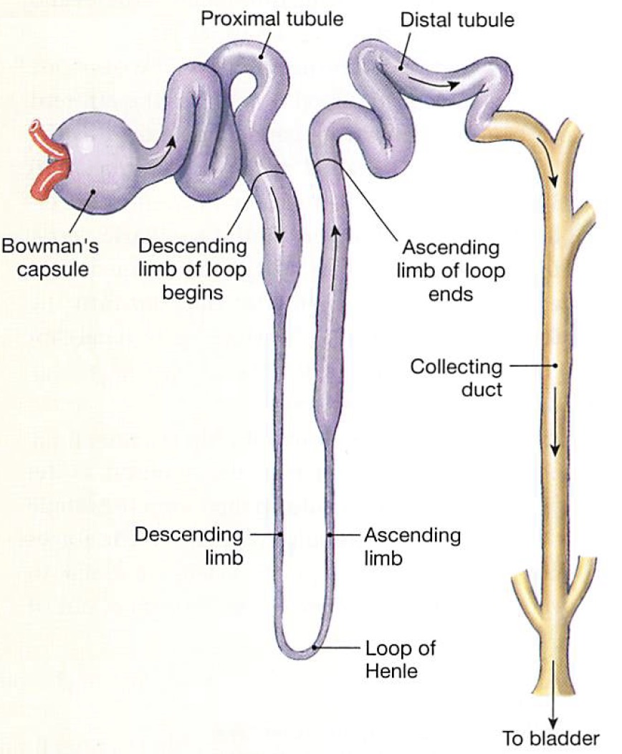
Renal Anatomy
Bowman’s capsule
Proximal (convoluted) tubule
Loop of Henle
  Thin descending limb
  Thin ascending limb
  Thick ascending limb
Distal tubule
Collecting duct
Distal tubule and collecting duct together form the distal nephron.

Slide 23
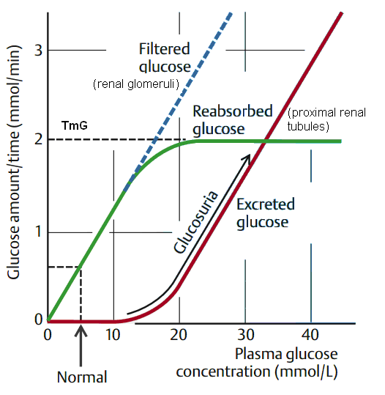
Movement of Materials
Transport maximum: maximum that can be reabsorbed per unit time. Usually occurs when transporters are saturated.

Slide 24
Changes in Glomerular Capillary Hydrostatic Pressure
As a result----
  Moderate levels of efferent arteriole constriction cause a slight increase in GFR.
  With severe constriction, there is a decrease in GFR due to a rapid buildup of oncotic pressure as blood moves through the glomerular capillaries.

Slide 25
Changes in Glomerular Capillary Hydrostatic Pressure
In contrast afferent arteriole constriction is straightforward:
  As afferent arteriole resistance increases, GFR decreases

Slide 26
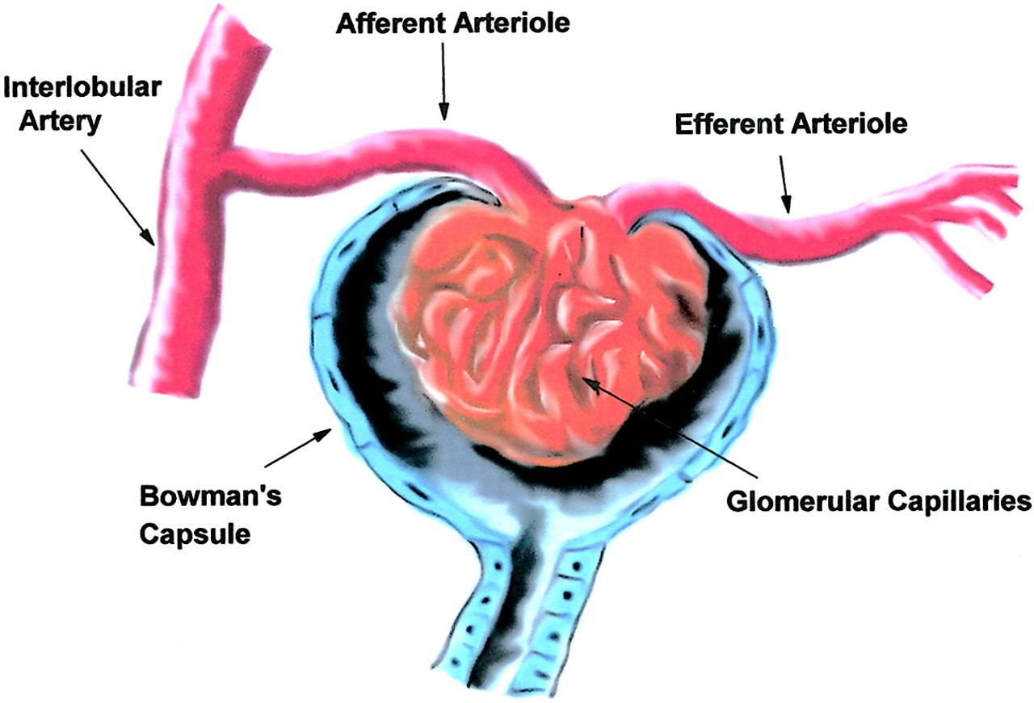
Changes in Glomerular Capillary Hydrostatic Pressure
Angiotensin II tends to preferentially constrict the efferent arteriole, thereby increasing GFR.
However, the effect is complicated as Ang II levels increase with low BP and high sympathetic activity.

Slide 27
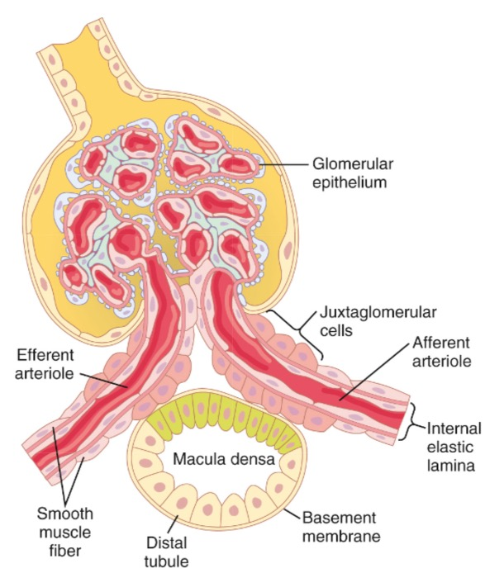
Tubuloglomerular Feedback
When Na⁺ is low, the macula densa cells release signaling molecules:
  Adenosine: causes dilation of afferent arteriole.
  Prostaglandins and others: cause JG cells to release renin (and efferent arteriole constriction).

Slide 28
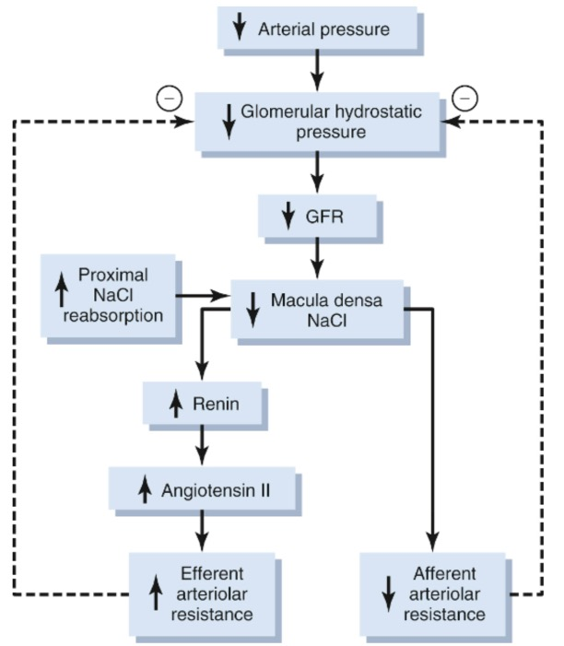
Tubuloglomerular Feedback
As a result:
  The afferent arteriole dilates and the efferent arteriole constricts.
  Hence, GFR increases.
  Tubuloglomerular feedback helps to stabilize GFR.

Slide 29
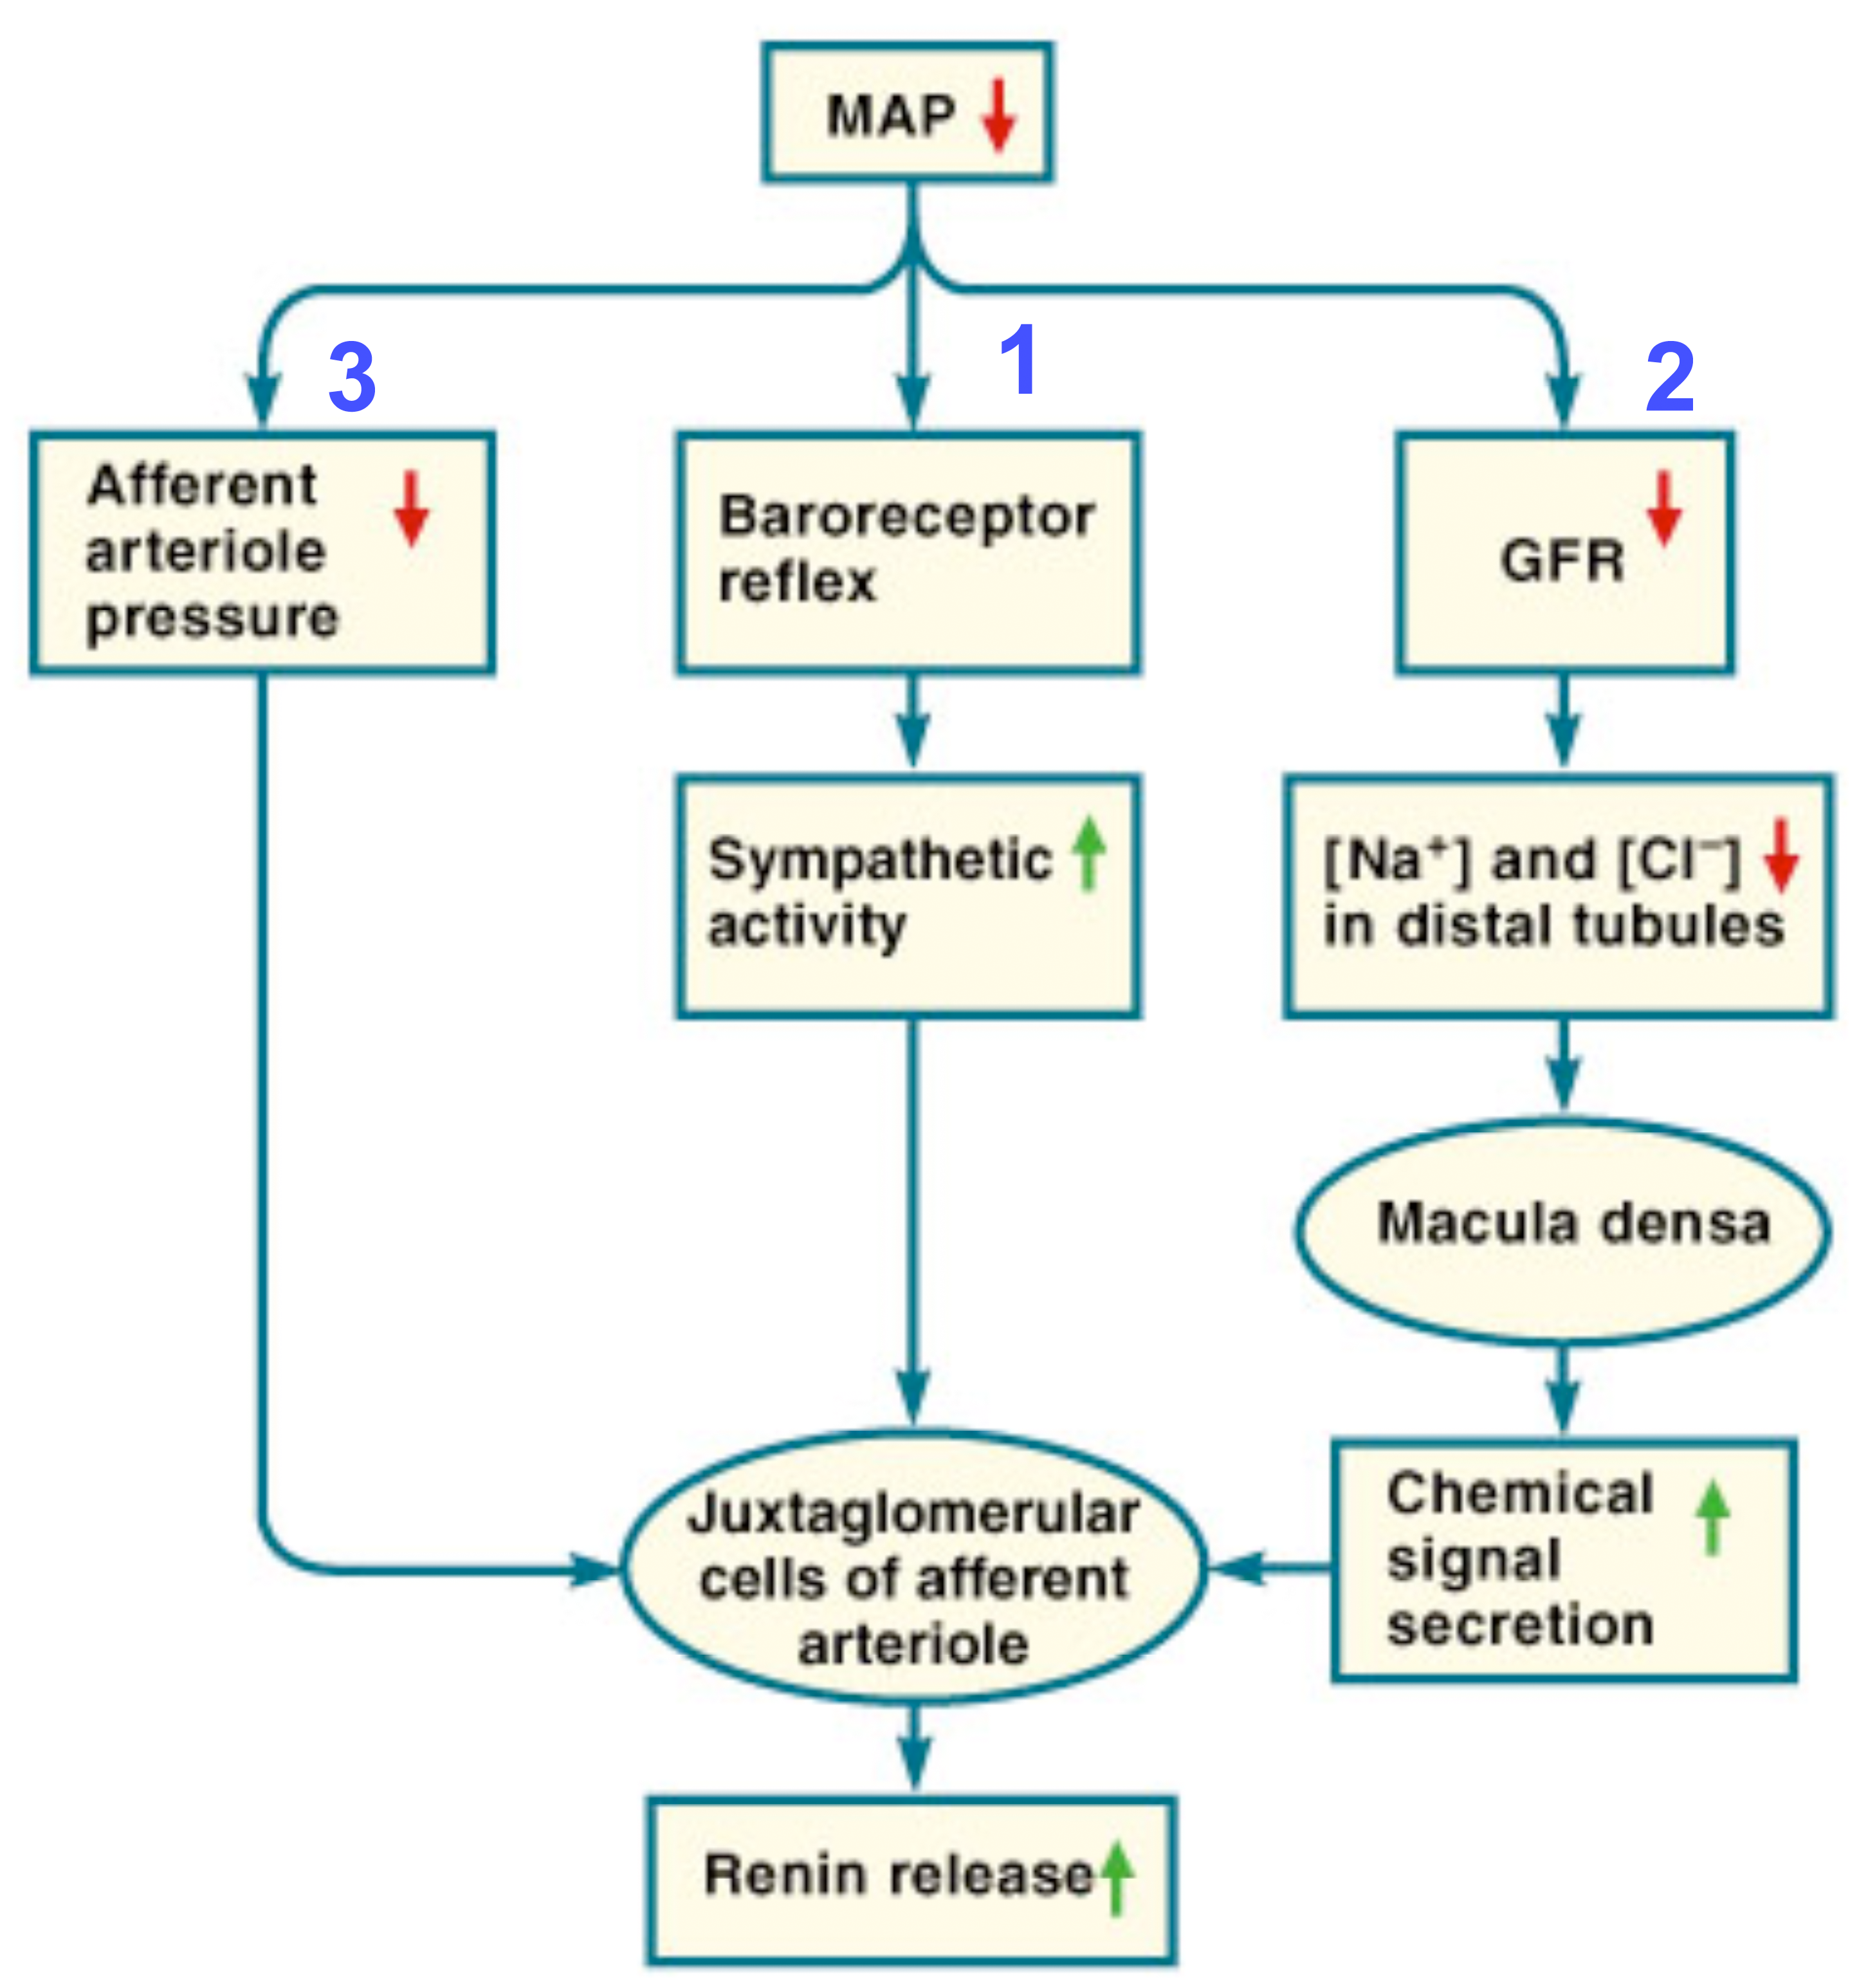
Review: Increase of Renin Release
β₁

Slide 30
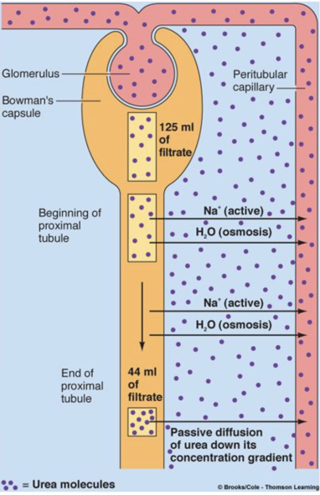
Osmosis Drives Absorption of Small Molecules
As water leaves the tubule, ions that are left behind are concentrated.
Consequently, if the tubule is permeable to them, they leave via diffusion.
An example is the nitrogenous waste molecule urea.

Slide 31
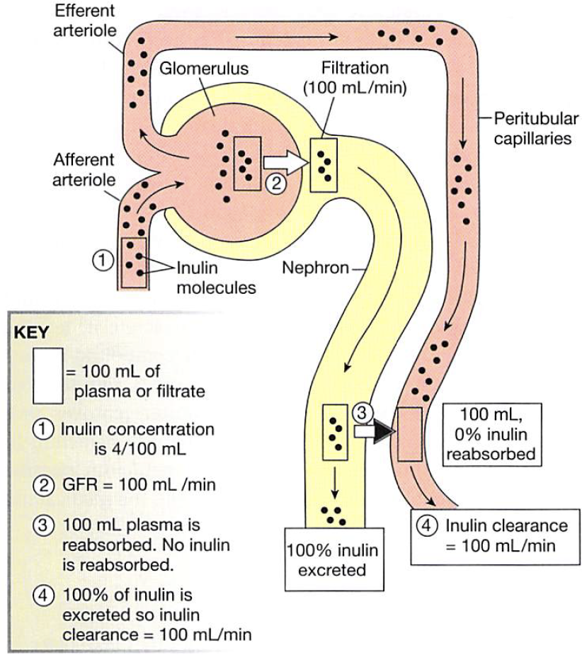
Clearance of Inulin
Excretion rate of inulin = [inulin]_{plasma}* GFR
OR
GFR =
Excretion rate of inulin / [inulin]_{plasma}

Slide 32
Clearance of Creatinine
Example:
  Plasma [creatinine] = 1.5 mg/dL
  Urine volume = 1.5 L/24 hours
  Urine [creatinine] = 1.44 gm/L
Thus,
  Urine flow rate = 1,500 ml/1440 min = 1.04 ml/min
  Urine [creatinine] = 1.44 gm/L = 1.44 mg/ml
  Plasma [creatinine] = 1.5 mg/dL = 0.015 mg/ml
  Creatinine Clearance = GFR = (1.04 ml/min x 1.44 mg/ml) / 0.015 mg/ml = 100 ml/min
Note that this estimate will be about 10% elevated, due to the small secretion of creatinine that elevates urine concentrations over that produced by filtration.

Slide 33
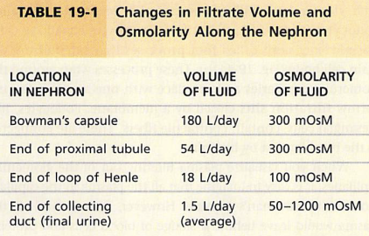
Osmolarity of Fluid in the Tubule Varies

Slide 34
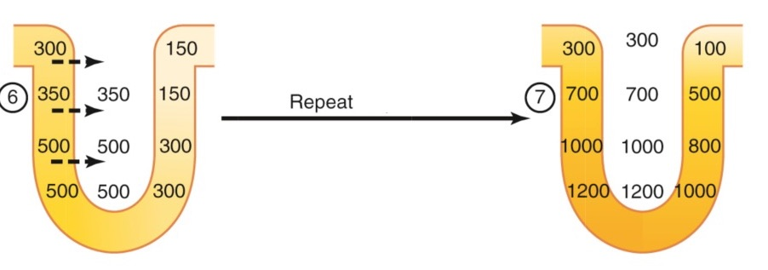
The Renal Countercurrent Multiplier
Repeated over and over, this results in high osmolarity in the renal medulla.

Slide 35
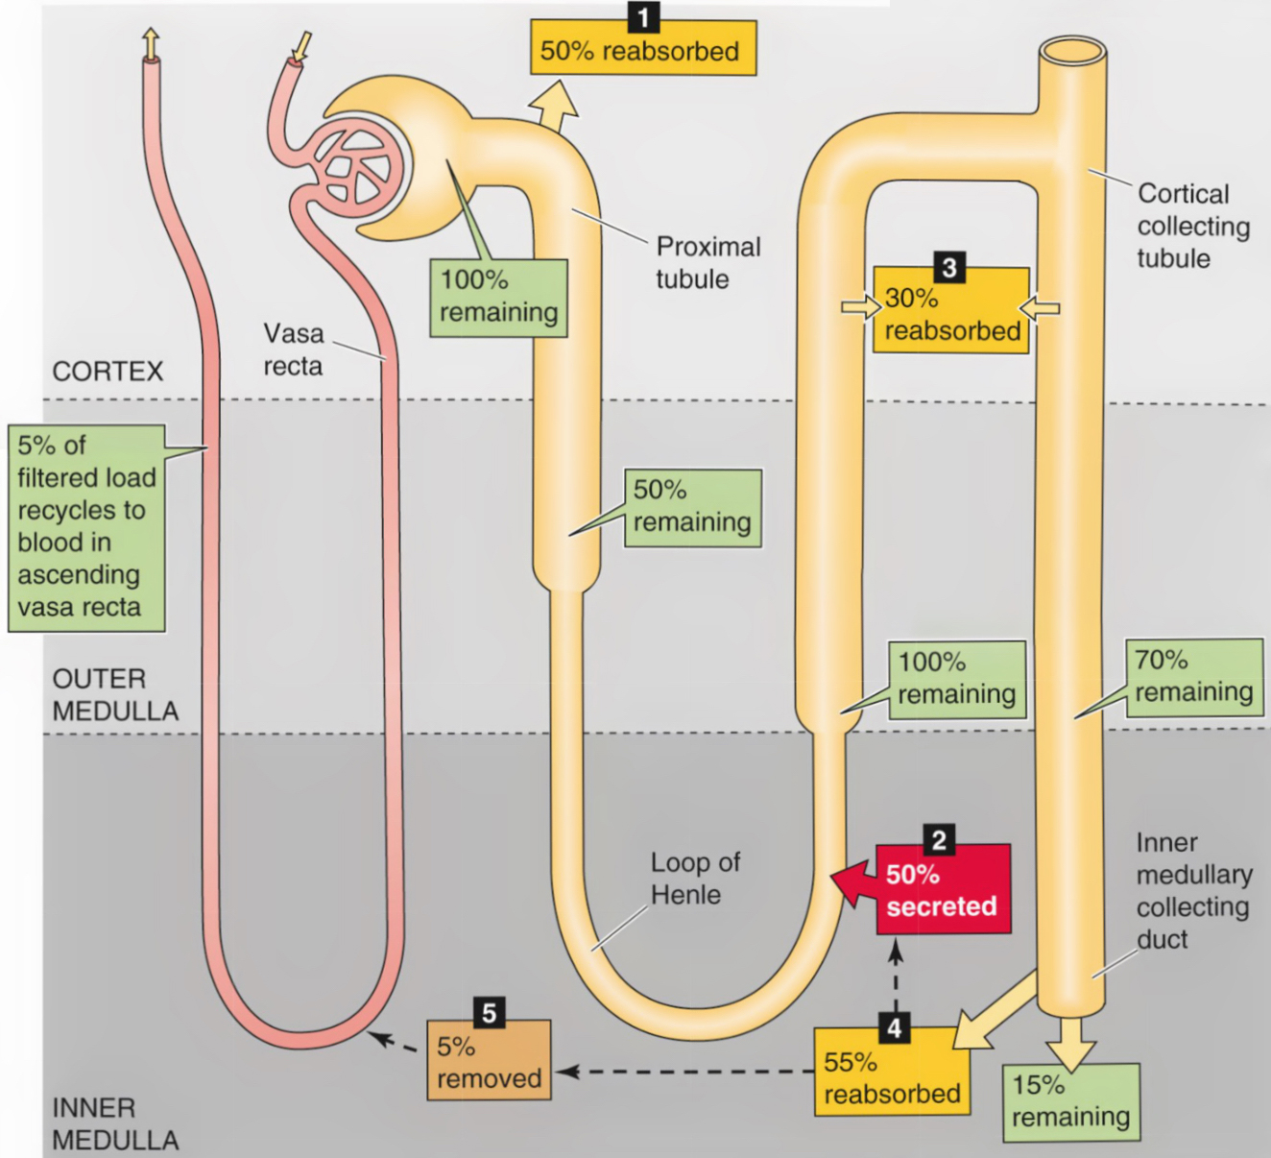
Urea Contributes to Medullary Osmolarity
Urea is reabsorbed in a regulated fashion in the collecting duct, adding to Na⁺ to create high medullary osmolarity.
Note that the molecule is recycled.

Slide 36
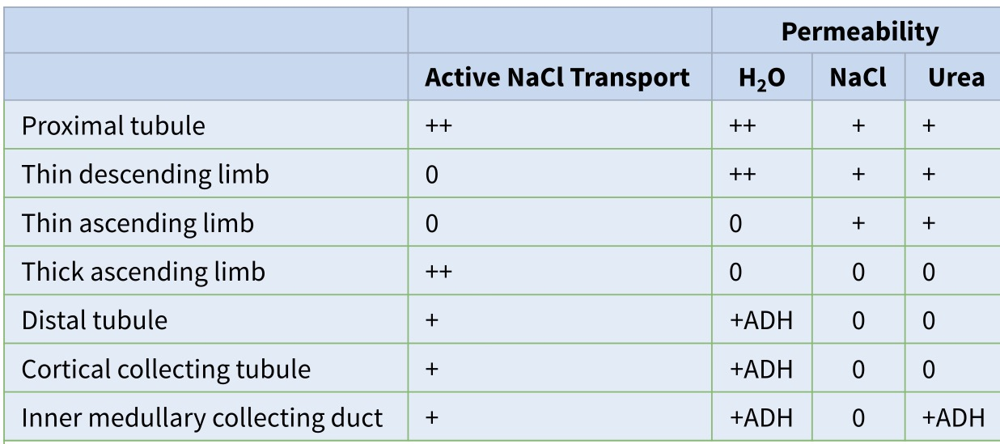
Vasopressin Regulates H₂O Reabsorption
Vasopressin (ADH) plays a key role in regulating H₂O (and urea) reabsorption.
As noted earlier, H₂O and NaCl reabsorption vary in different parts of the nephron.

Slide 37
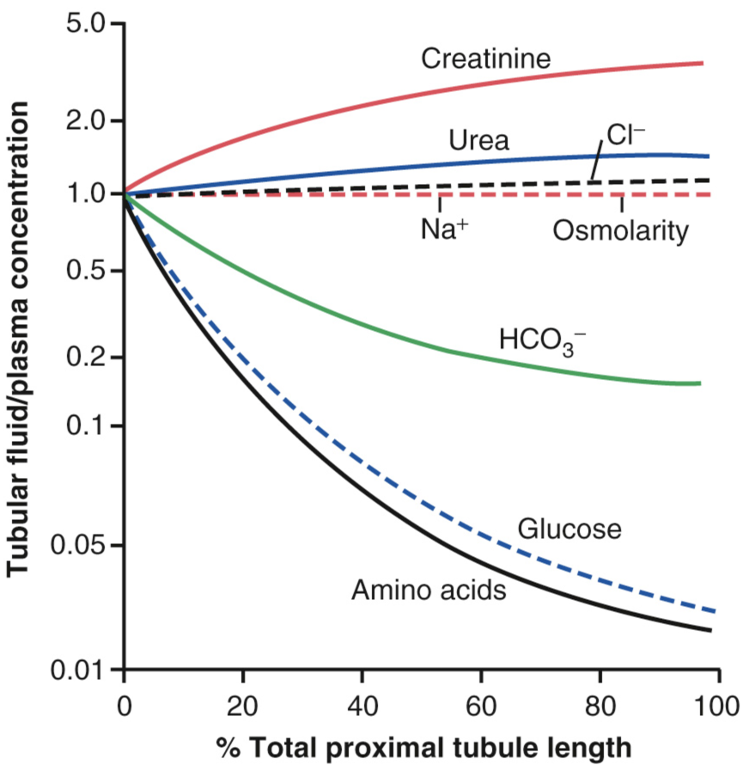
Proximal Tubule
Glucose and amino acids are virtually all absorbed in the proximal tubule, and substantial HCO₃⁻ absorption occurs as well.
Some substances (e.g, creatinine) increase in concentration along the proximal tubule, as water leaves by osmosis.

Slide 38
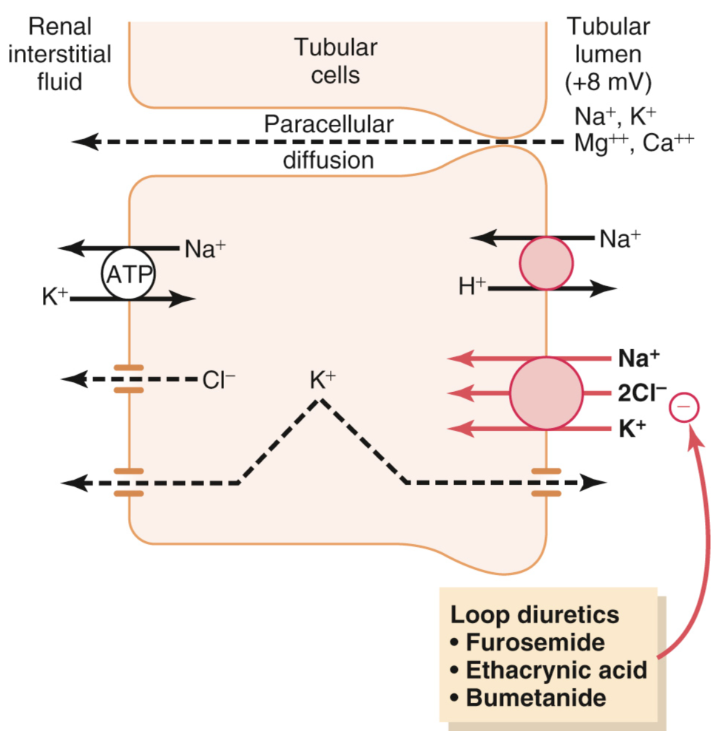
Loop of Henle (thick ascending limb)
Impermeable to water
Active transport of many ions. A major contributor is the 1-sodium, 2-chloride, 1-potassium co-transporter, which is “powered” by the Na⁺ - K⁺ pump.
A Na⁺ - H⁺ exchanger is also present, as in the proximal limb.

Slide 39
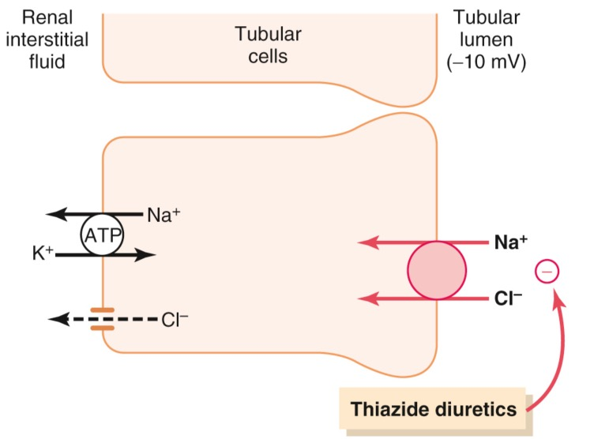
Early Distal Tubule
5% of the filtered load of NaCl is reabsorbed in the early distal tubule via the sodium-chloride co-transporter.
Thiazide diuretics inhibit this co-transporter.

Slide 40
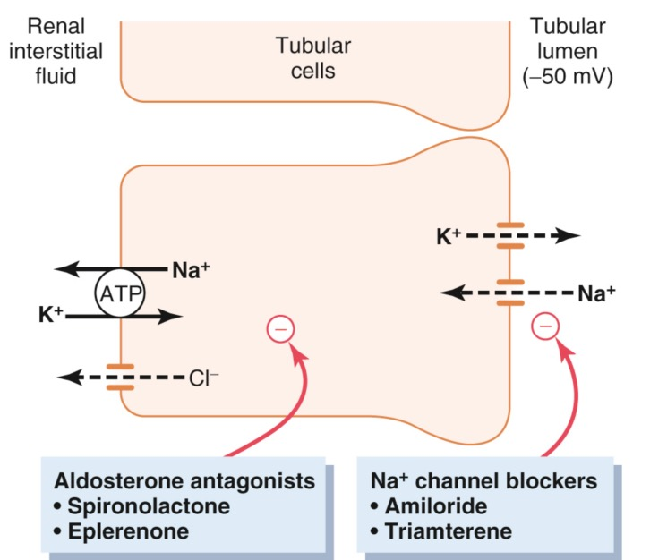
Late Distal Tubule and Collecting Duct
Principal cells play a prominent role in K⁺ secretion.
The hormone aldosterone enhances K⁺ secretion by up-regulating epithelial Na+ channels (ENACs) and stimulating the Na⁺ - K⁺ pump.
ENAC

Slide 41
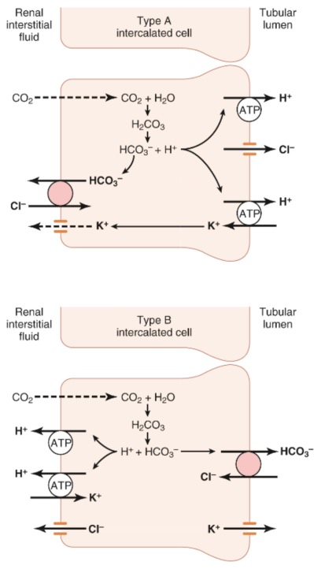
Late Distal Tubule and Collecting Duct
Intercalated cells play a major role in acid-base regulation.
Type-A intercalated cells secrete H⁺ ions via a H⁺ ATPase and a H⁺ - K⁺ ATPase.
The cells reabsorb HCO3⁻ for every H⁺ that is secreted.
These cells play a key role in eliminating H⁺ during acidosis.

Slide 42
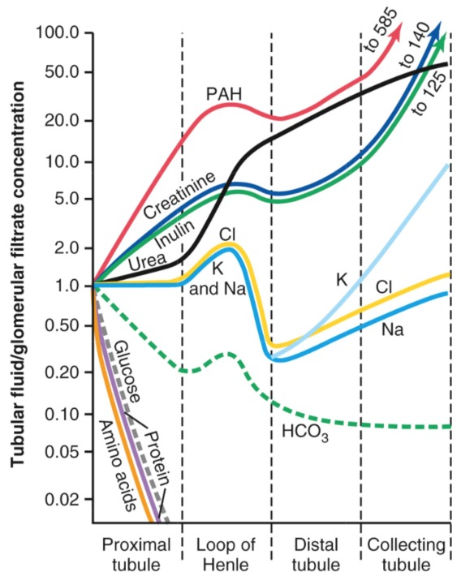
Summary of Tubule Concentrations
Some substances are totally reabsorbed in the proximal tubule.
Others increase in concentration as water is reabsorbed.

Slide 43
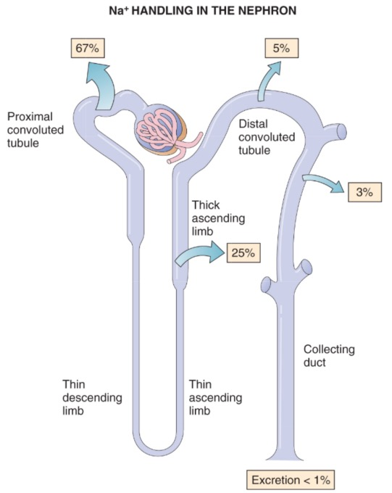
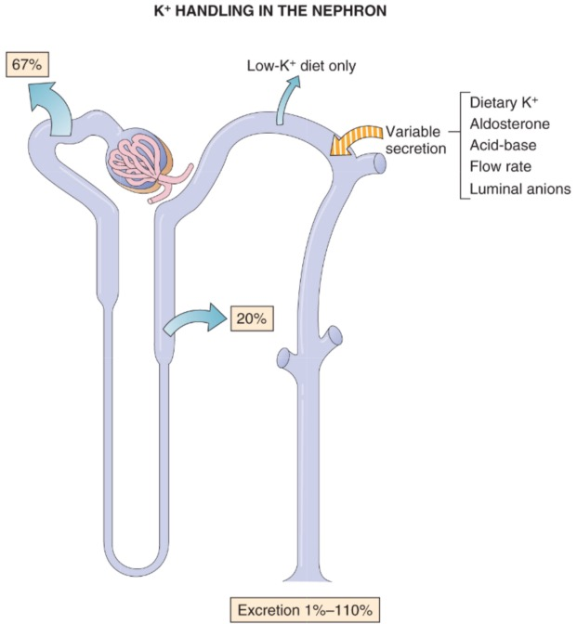

Slide 44
Hormones that Affect Reabsorption
Vasopressin
Angiotensin II
Aldosterone
Atrial Natiuretic Peptides
Parathyroid Hormone
Erythropoietin

Slide 45

Trick: Use PAH to Estimate Renal Blood Flow
PAH = para-aminohippurate
PAH is freely filtered and secreted, but not reabsorbed.
A small injection of PAH is almost completely cleared in one pass through the kidney.
Thus P_{v} for PAH is 0

Slide 46
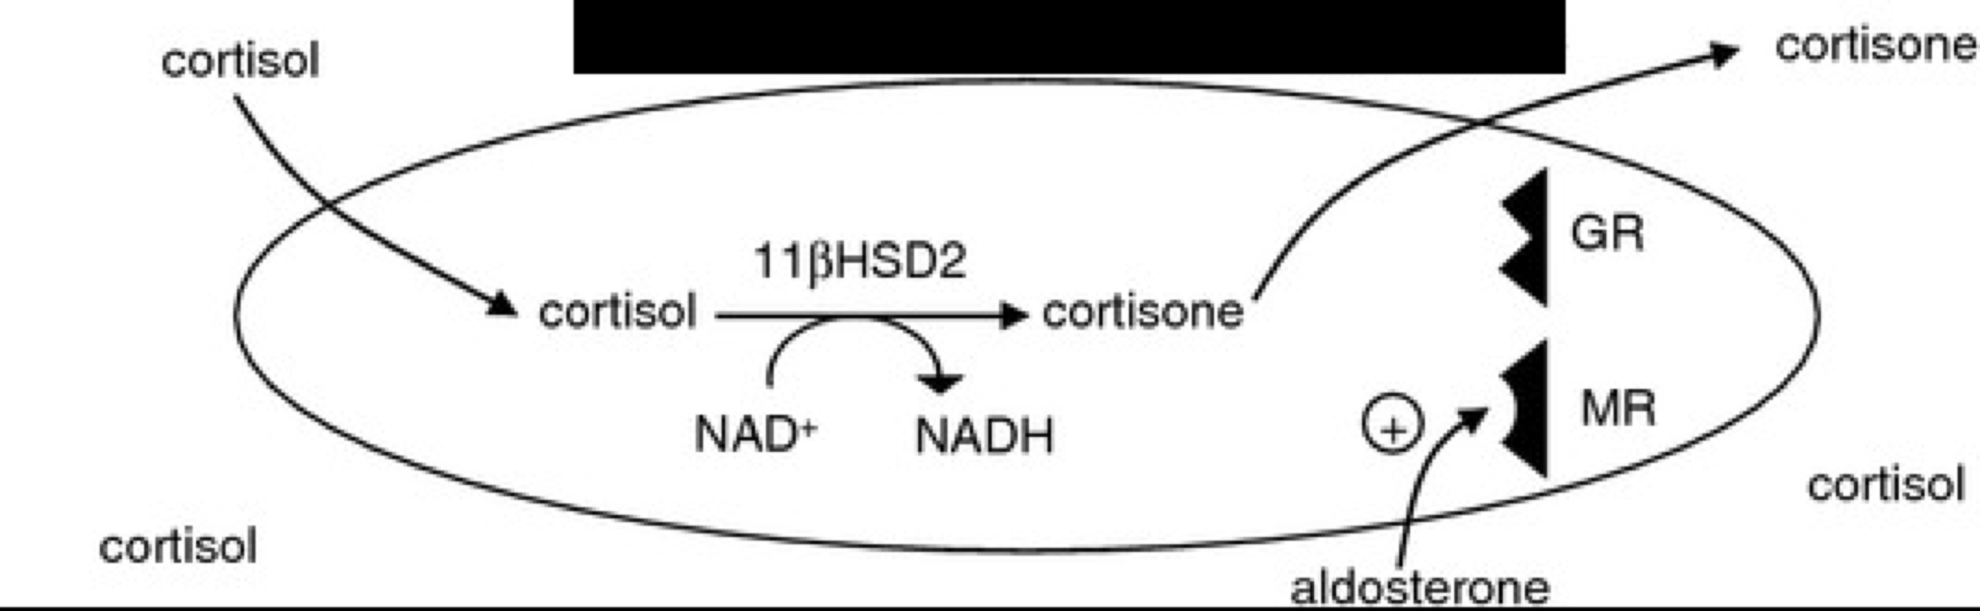
Mineralocorticoid Excess
Patients with Apparent Mineralocorticoid Excess Syndrome have a defective 11βHSD2 gene, and as a result have over-activation of the aldosterone receptor.
This results in water retention, high blood pressure (due to a high blood volume), and hypokalemia.
This is an autosomal recessive disorder.

Slide 47
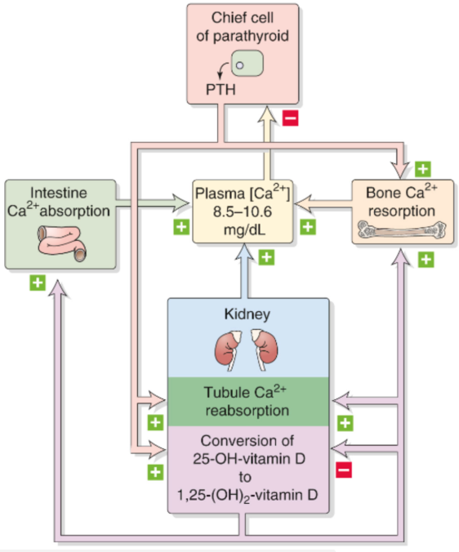
Parathyroid Hormone/Calcitriol
In summary, PTH and calcitriol act to enhance plasma Ca²⁺, mainly through actions in the intestine and kidney.
If plasma Ca²⁺ is low, PTH secretion increases, inducing the production of high levels of calcitriol that together (with PTH) act to mobilize Ca²⁺ from bone and increase Ca²⁺ transport in the kidney and gut.

Slide 48
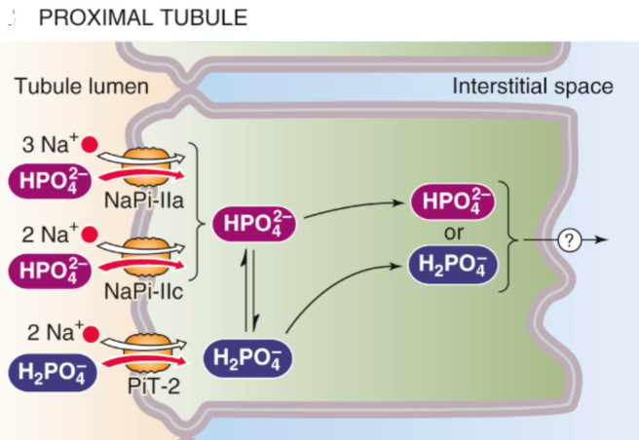
Phosphate Metabolism
Despite these diverging mechanisms, the net effect of PTH is a loss of phosphate from the plasma, as the renal actions predominate.

Slide 49
Fibroblast Growth Factor 23
FGF23 acts on the kidneys, where it decreases the expression of NPT2, a sodium-phosphate cotransporter in the proximal tubule.
Thus, FGF23 decreases the reabsorption and increases excretion of phosphate.
FGF23 also suppresses the synthesis of calcitriol in the kidney

Slide 50
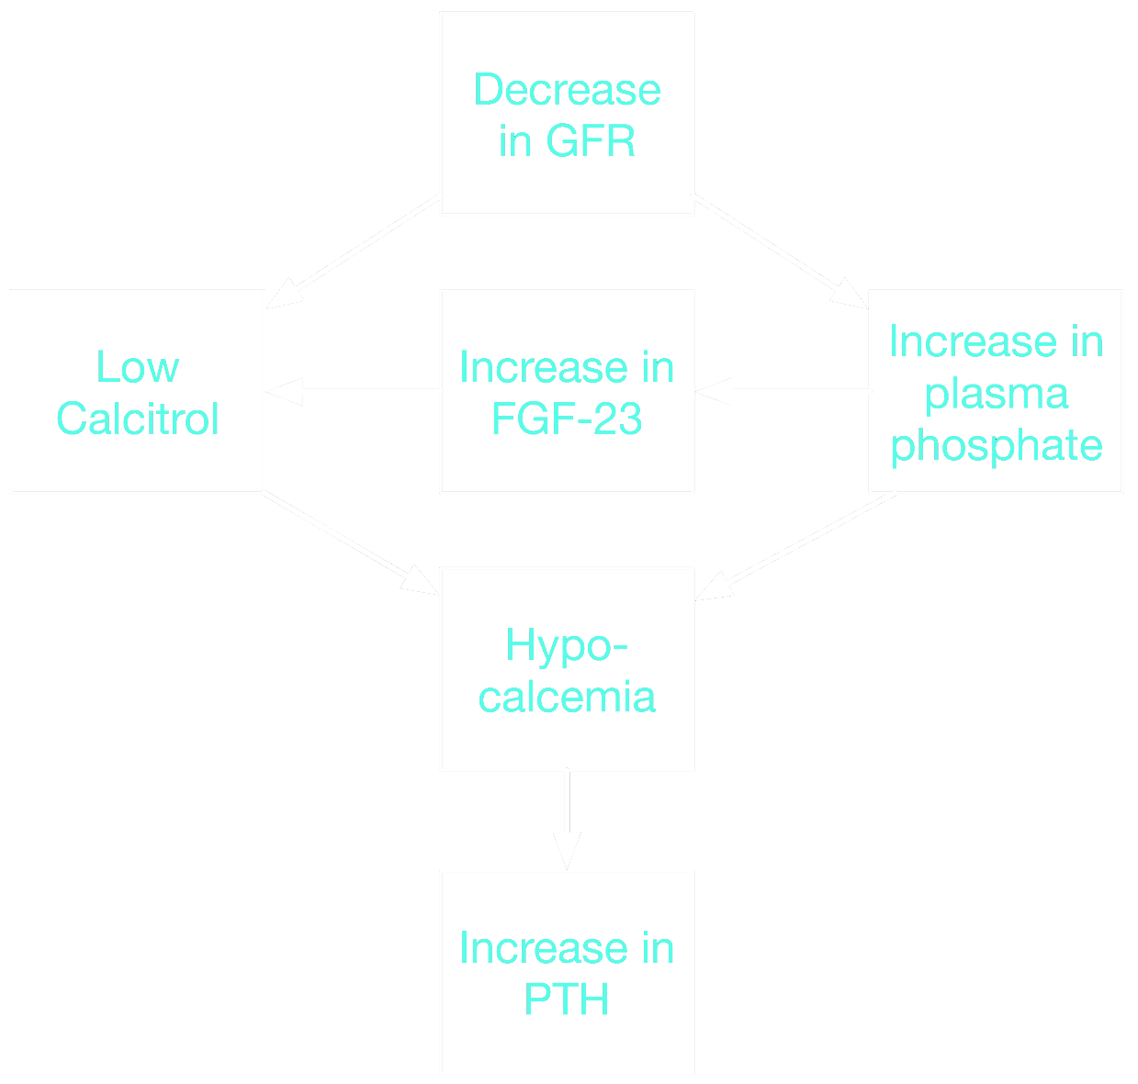
Renal Failure and Ca²⁺
Renal failure results in a decline in Calcitriol production
High levels of plasma phosphate during renal failure increase FGF23, which further impairs Calcitriol synthesis.
As a result, there is a profound deficit in Calcitriol, leading to hypocalcemia.

Slide 51
Hypercalcemia
Usually results from a parathyroid tumor and uncontrolled release of PTH, or bone metastasis that results in bone breakdown
High calcium blocks Na+ entry through voltage-gated Na+ channels
  Consequence: excitable membranes are less excitable
  Harder to initiate neuronal action potentials, resulting in lethargy, depression, and sometimes coma
  Harder to initiate muscle action potentials, resulting in muscle weakness
  Cardiac myocytes are less depolarized, so repolarization is easier. The Q-T interval shortens.
Increased filtration of Ca2+ can result in kidney stones
Water follows the increased ionic load in filtrate, resulting in dehydration, hypotension, and cardiovascular collapse

Slide 52
Hypocalcemia
Can result from failure of the parathyroid gland, absent vitamin D, or alkalosis
  Albumin binds positively charged ions. H+ is displaced from albumin during alkalosis, allowing more binding of Ca2+. Thus, free Ca2+ in the plasma decreases.
Drops in plasma Ca2+ facilitate the movement of Na+ through voltage-gated Na+ channels. Thus, excitable membranes are more excitable.
  Enhanced neural activity can produce seizures and convulsions
  Enhanced muscular excitability can result in involuntary contractions
  Ventricular tachycardia and fibrillation can occur
  Paradoxically, prior to tachycardia the Q-T interval can be prolonged, as it takes longer to repolarize ventricular myocytes. Thus, heart rate tends to initially decrease during hypocalcemia.

